Slide 1

SIM 3150
MODULE 1 : USER MANAGEMENT & AUTHENTICATION
LECTURER : DR. NG KENG YAP
GROUP MEMBERS : MU’AZ TOSHIHIKO BIN MANSOR 179117 WAN NORIZZATI BINTI WAN HASAN 178898 SYAFIRA BINTI MOHD SOFIAN 179771
NOR AZMIRA BINTI DOMAN 176553
NURUL AFIQAH BINTI AZMAN 178688

Slide 2
INTRODUCTION
Give a detailed description of the requirements for the Accounting system for module 1. This module 1 is about the user management and authentication. This Accounting System is a medium for company directors and company secretary, accountants, auditors, accountants delegate and auditors delegate and admin to interact. We serve the purpose of simplifying task and also offer productive measure for all users.

Slide 3
OBJECTIVE
The objective of this module is to allow user to authenticate into our system.
This module determine level of accessibility of each type of user
From this module, user can request new role by fill out the form and submit to admin for approval.

Slide 4
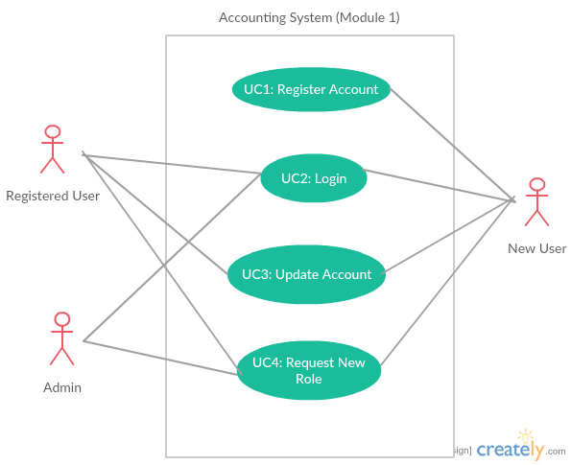
USE CASE

Slide 5
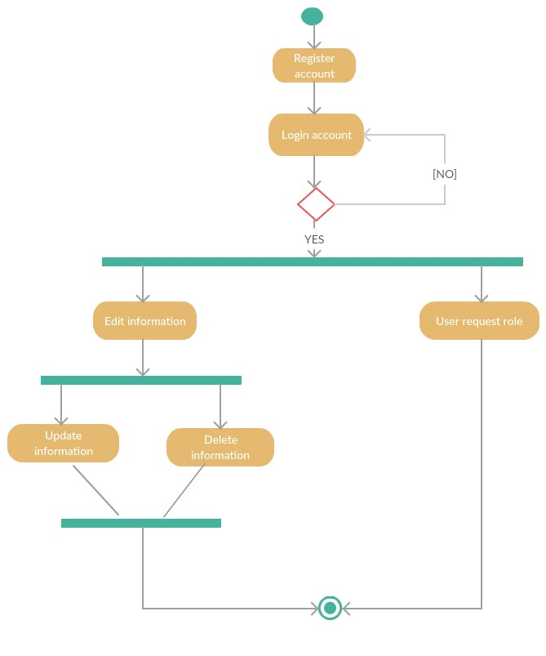
ACTIVITY DIAGRAM

Slide 6
NON-FUNCTIONAL REQUIREMENTS
Performance - Response time should be in 2 seconds or less.
Security - The system must be encrypted to protect the database.
Availability - Under normal operation, the downtime percentage is maximum 10%
Scalability - The maximum response during peak hours is 5 seconds.

Slide 7
Architechture Design

Slide 8
ARCHITECTURE PATTERN & STYLE
For this modul 1, we use client-server architecture style because the main operation of the system is done online for example the functionality to check trial balance.
MVC architecture pattern also can be used because of its compatibility with client-server architecture
MVC also allows a separation of each module so it is easier to use.

Slide 9
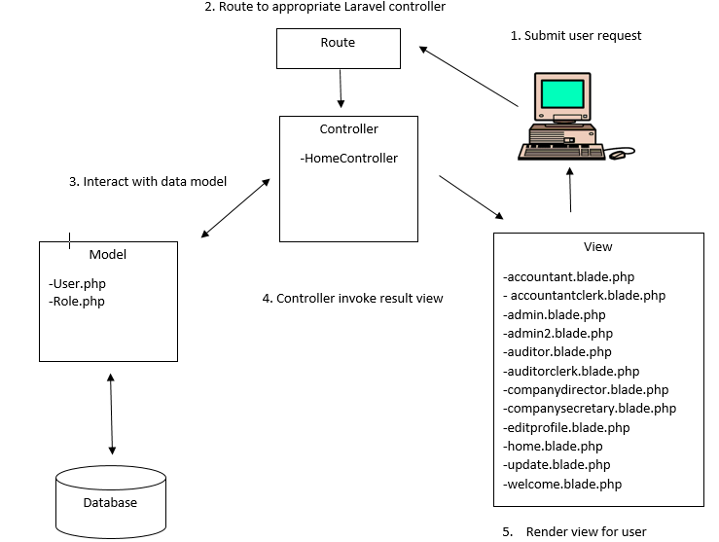

Slide 10
Physical view

Slide 11
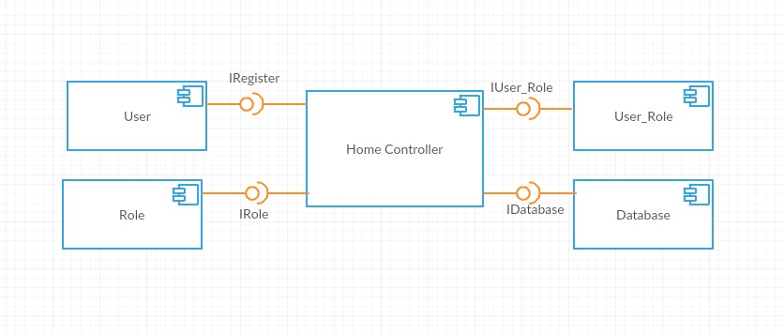
Component Diagram

Slide 12
ENTITY-RELATIONSHIP DIAGRAM

Slide 13
HOW THIS MODULE INTEGRATE WITH ANOTHER MODULE?
This user management and authentication module integrated with administrator dashboard module as admin need to approve the user request to have more than one role such as user, an accountant, request to be an auditor. He/she will fill out the form for the request and it is admin’s task to approve it. After admin approve his/her request, user will get notification from admin whether his/her request is approved or not.

Slide 14
DEMO

